Slide 1

Reviewers’ Guides:
Locating, Choosing, and Downloading
Notes:
Would you be able to make a PPT to show how to download the PDFs of the ULB and Notes/questions/words from BIEL? And would you also be able to make one that shows how to find the RG and choose which format and how to download it?

Slide 2

Go to the Translations Page
Click on the ‘Translations’ link located in the top menu bar.

Slide 3
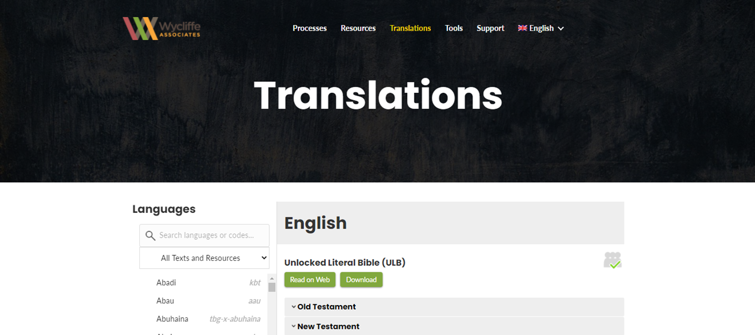
The Translations Page opens to English

Slide 4
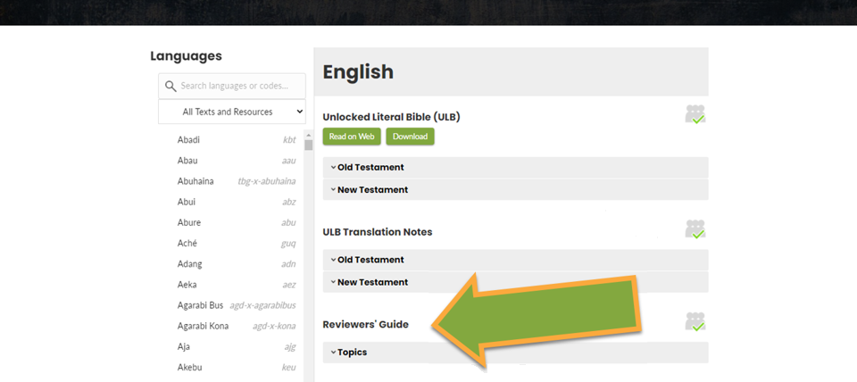
Scroll down to the Reviewers’ Guide section.

Slide 5
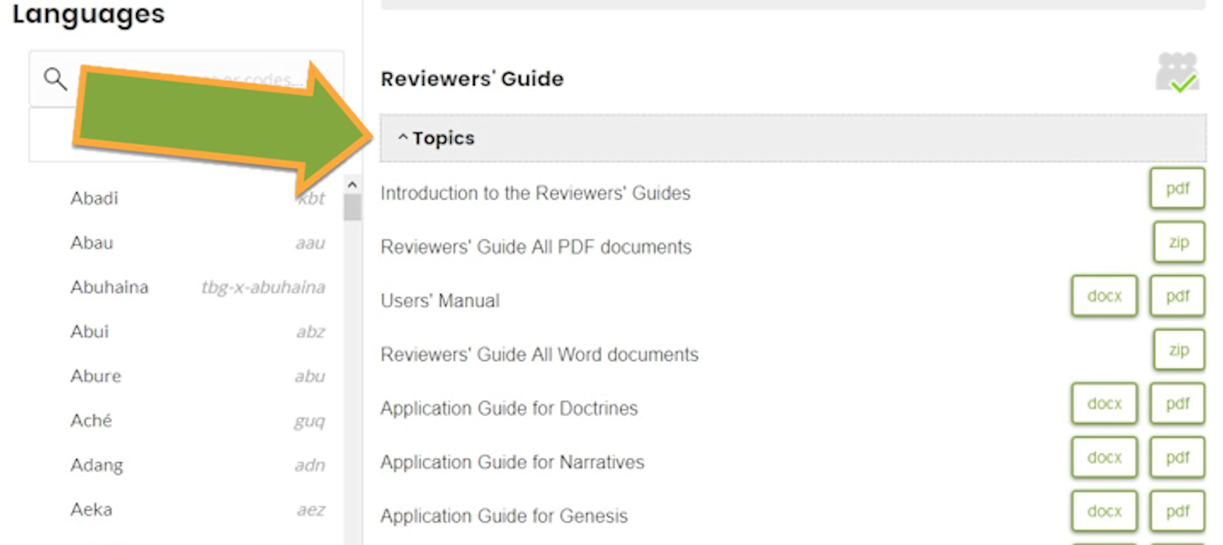
Reviewers’ Guide section… Click to expand “Topics”

Slide 6
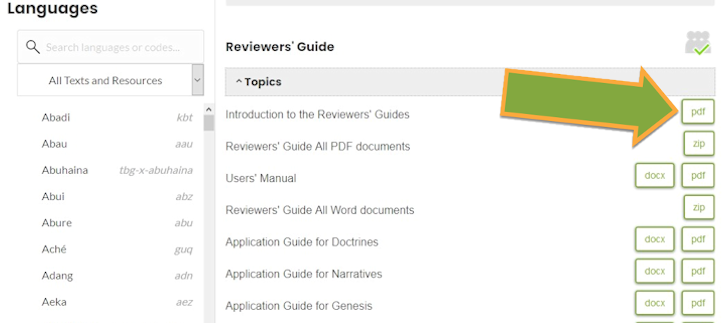
On the right, Click the appropriate button to open the chosen Reviewers’ Guide.

Slide 7
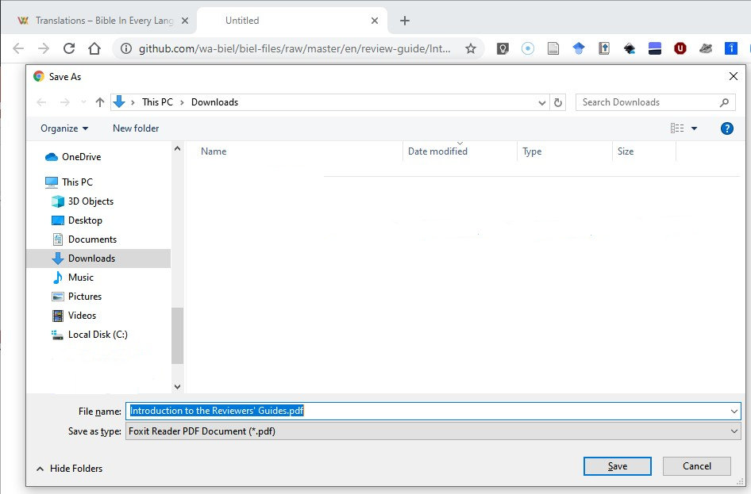
A save dialogue box may open for the FILE of the chosen resource (i.e. DOCX, ZIP or PDF).
Choose a save location, then click “Save”.

Slide 8
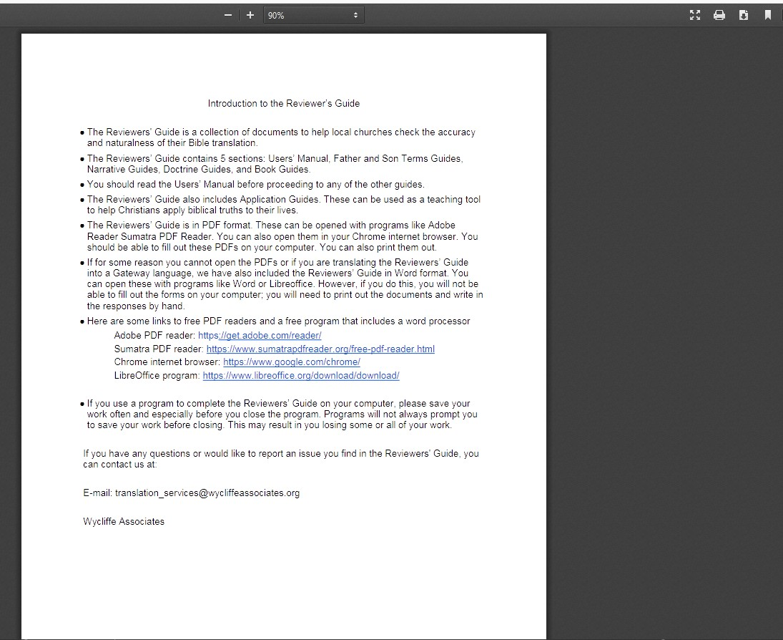
When the chosen resource opens in a new tab in your browser…

Slide 9
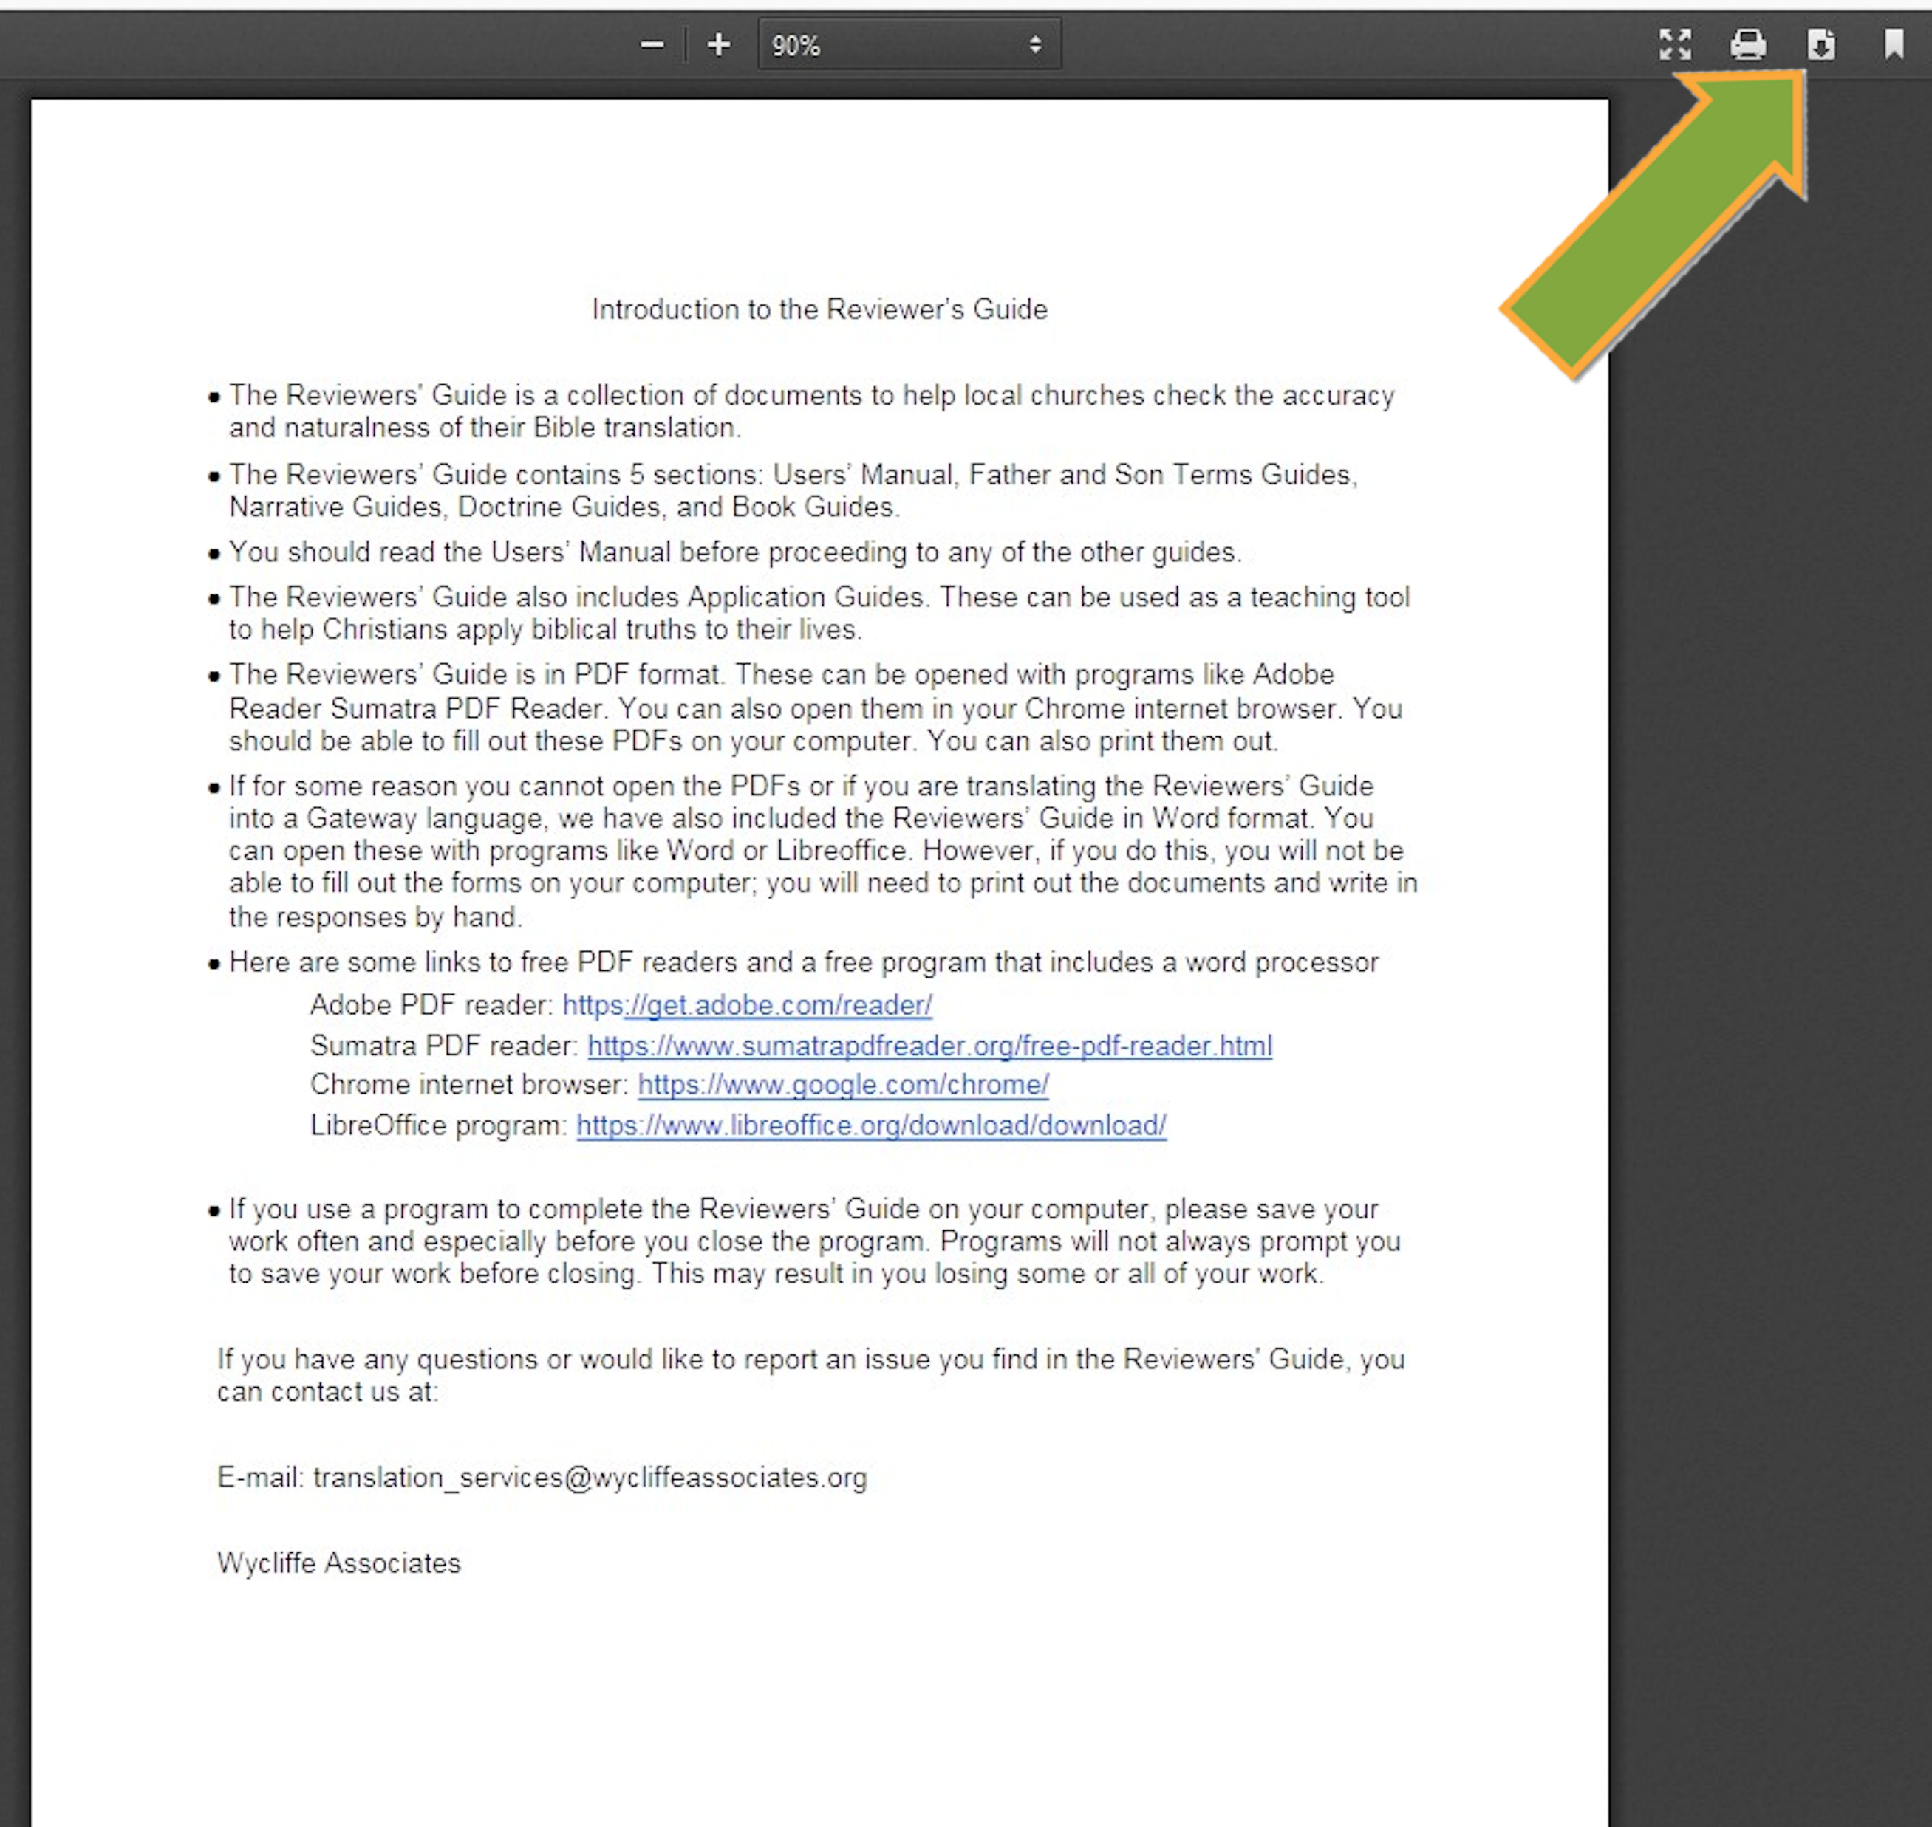
Click the download button to open the save dialogue box.
Choose a save location, then click “Save”.

Slide 10
Choosing File Format to Download
Reviewers’ Guides are available in DOCX and PDF format …
Reviewers’ Guides are also available as ZIPs
How do I choose? What is the difference?
Notes:
Would you be able to make a PPT to show how to download the PDFs of the ULB and Notes/questions/words from BIEL? And would you also be able to make one that shows how to find the RG and choose which format and how to download it?

Slide 11
Choosing the Reviewers’ Guide format(s) to Download
RGs are available for download in DOCX and PDF formats
What are the differences between DOCX and PDF?
The DOCX format is a Microsoft Word document that may be viewed and edited in any standard word processing program.
The PDF format is an Adobe-compatible format that may be viewed with any PDF reader and in most internet browsers. The Reviewer’s Guides are PDF forms that may be filled out, but cannot be changed or edited.
For more information, please see the “Introduction to the Reviewers’ Guides” on the BIEL website.
What is the purpose of the ZIP option?
ZIP files contain ALL the PDF or DOCX files in a single download

Slide 12
Choosing the Reviewers’ Guide format(s) to Download
How do I choose between DOCX and PDF?
First, consider how you want to use the Reviewers’ Guide and how you will be sharing it with others.
Will you need to edit the Reviewers’ Guide?
Would you like to translate the Reviewers’ Guide into your language?
Is your storage space limited? on your hard drive or your flash drive?
Is bandwidth and/or internet speed an issue?
File Format Comparisons
The DOCX file is editable and is usually smaller in size than the PDF.
Except where designed to be editable, the PDF file cannot be easily altered, and is safer from accidental changes.
For more information, please see the “Introduction to the Reviewers’ Guides” on the BIEL website.

Slide 13
Which file format to choose
What is the best choice to make if: I want to fill out a form during the review…
pdf – used in a PDF reader
docx – print out and write responses on the form
zip – not the best choice

Slide 14
Which file format to choose
What is the best choice to make if: I want to translate the document…
pdf – generally cannot be edited
docx – open in Word or Libre Office to edit
zip – not the best choice for this purpose

Slide 15
Which file format to choose
What is the best choice to make if: I have undependable Internet access…
pdf – individual files are larger than docx files
docx – individual files are smaller than pdf files
zip – the files are 2,000KB or 10,000KB large, but once downloaded, all files are available off-line

Slide 16
Which file format to choose
What is the best choice to make if: I have a slow Internet connection…
pdf – individual files are larger than docx files
docx – individual files are smaller than pdf files
zip – the files are 2,000KB or 10,000KB large

Slide 17
Helpful Information
Using Reviewers’ Guides (RGs)
Start with the “Introduction to the Reviewers’ Guides” document
https://raw.githubusercontent.com/wa-biel/biel-files/master/en/review-guide/Introduction%20to%20the%20Reviewers'%20Guides.pdf
Download and read the Users’ Manual
https://raw.githubusercontent.com/wa-biel/biel-files/master/en/review-guide/Reviewers'%20Guide%20PDF%20documents/Users'%20Manual.pdf
Consider downloading ALL of the current RGs in a single .ZIP file
https://github.com/wa-biel/biel-files/raw/master/en/review-guide/Reviewers%27%20Guide%20PDF%20documents/Reviewers%27%20Guide%20All%20PDF%20documents.zip

Slide 18


